Slide 1
Indian Institute of Information & Technology,
Bhopal
ECE 7th Sem.
Major Project -2023
Meet the Dynamic Team of Group No. 12
Abhishek Brajvasi (Scholar No. 20U01047)
Arpeet Bhaisare (Scholar No. 20U01041)
Samarth Varshney (Scholar No. 20U01024)
Supervisor: Dr. Bhupendra Singh Kirar

Slide 2

Introducing Arduino Voice Controlled Relay for Home Automation
Explore the world of smart home technology and learn how to integrate voice control in your home devices with Arduino Relay and Bluetooth technology.

Slide 3
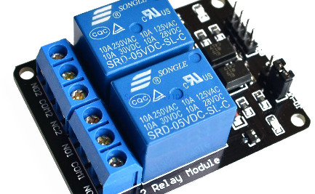
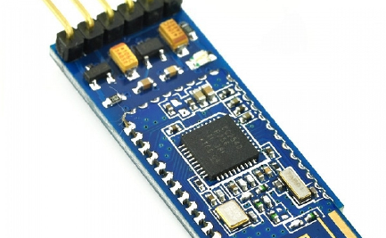
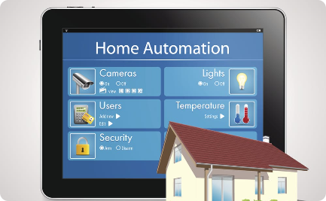
Arduino Relay and Bluetooth Module
Arduino Relay Module
Bluetooth Module
Smart Home Automation
Easily control high voltage devices with Arduino Relay Module. It's easy to set up and perfect for home automation projects.
Make your smart home wireless with Bluetooth Module. It's the perfect companion for Arduino Relay and allows wireless control of your home automation system.
Explore the smart home automation world with Arduino Relay and Bluetooth. Build your own systems and make your daily life easier and more comfortable.

Slide 4
Voice Recognition for Home Automation
1
Voice Recognition Technology
Discover the voice recognition technology and learn about its development and applications in home automation systems.
Integrating Voice Recognition with Arduino Relay
2
Explore the process of integrating voice recognition with Arduino Relay, and learn the technical details of how the system works.
3
Creating Custom Voice Commands
Customize your home automation system by creating unique voice commands for your devices using a few simple programming steps.

Slide 5
Building Voice Controlled Home Automation System
Equipment Required
Step-by-Step Guide
Discover the equipment required to build a voice-controlled home automation system and ensure its proper functioning.
Learn how to build your own voice-controlled home automation system with a step-by-step guide and helpful tips to avoid common mistakes.
Arduino Programming
Testing and Troubleshooting
Get hands-on programming experience and learn how to integrate your voice commands with the Arduino Relay module.
Test your system and learn how to troubleshoot any issues that arise. Ensure that your home automation system is always functional.

Slide 6

Advantages of Voice Controlled Home Automation
1
Convenience and Ease of Use
2
Energy Efficiency
3
Enhanced Security and Safety
Maximize energy efficiency in your home and reduce costs by automating devices and using them only when necessary.
With voice control, control your home automation system with ease and convenience without the hassle of traditional buttons and switches.
Stay secure and ensure your family's safety by using voice commands to control your surveillance and alarm systems.

Slide 7

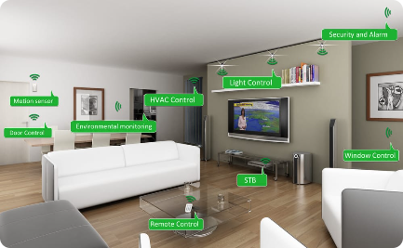
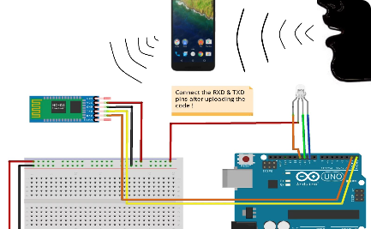
Conclusion
Future Prospects
Recap of Key Points
Arduino Voice Control Development
Explore the future prospects of home automation technology, and learn how voice control is the key to the next generation of smart homes.
Recap the key points of the presentation and learn the crucial concepts of building a voice-controlled home automation system.
Discover the latest Arduino voice control developments and stay up-to-date with the most innovative smart home technology.

Slide 8
THANK YOU

